Slide 1

Rubrics Generator
Transforming Grading with Intelligent Automation
By
Ansh Aya

Slide 2

Introduction
Generate customized rubrics by selecting options that suit your needs, and engage with the chatbot for tailored, user-specific requirements.
Leveraging technologies like Retrieval-Augmented Generation (RAG), the system enriches rubric creation with contextual knowledge, enhancing accuracy and effectiveness.
An AI-driven automated rubric generation system utilizing LLMs & AI, through advanced data input, criteria definition, and inclusive reporting, resulting in improved educational outcomes.

Slide 3
Business Objective
Ensure Consistent and Fair Assessments: Deploy advanced AI and LLM technologies to standardize grading criteria, ensuring fairness and reliability in assessments across diverse educational contexts, leading to improved trust and satisfaction among stakeholders.
Enhance Educational Efficiency: Implement the AI-driven Automated Rubric Generation System to reduce grading time, allowing educators to focus more on teaching and student engagement, thereby improving overall educational productivity.

Slide 4



System Description
The system combines Chroma, a robust vector database engine, with large language models (LLMs) renowned for their natural language understanding capabilities. Langchain's comprehensive framework facilitates the development of advanced features such as selecting options and uploading files. This integration enables the system to accurately understand and respond to diverse queries, generating precise and tailored rubrics efficiently.

Slide 5
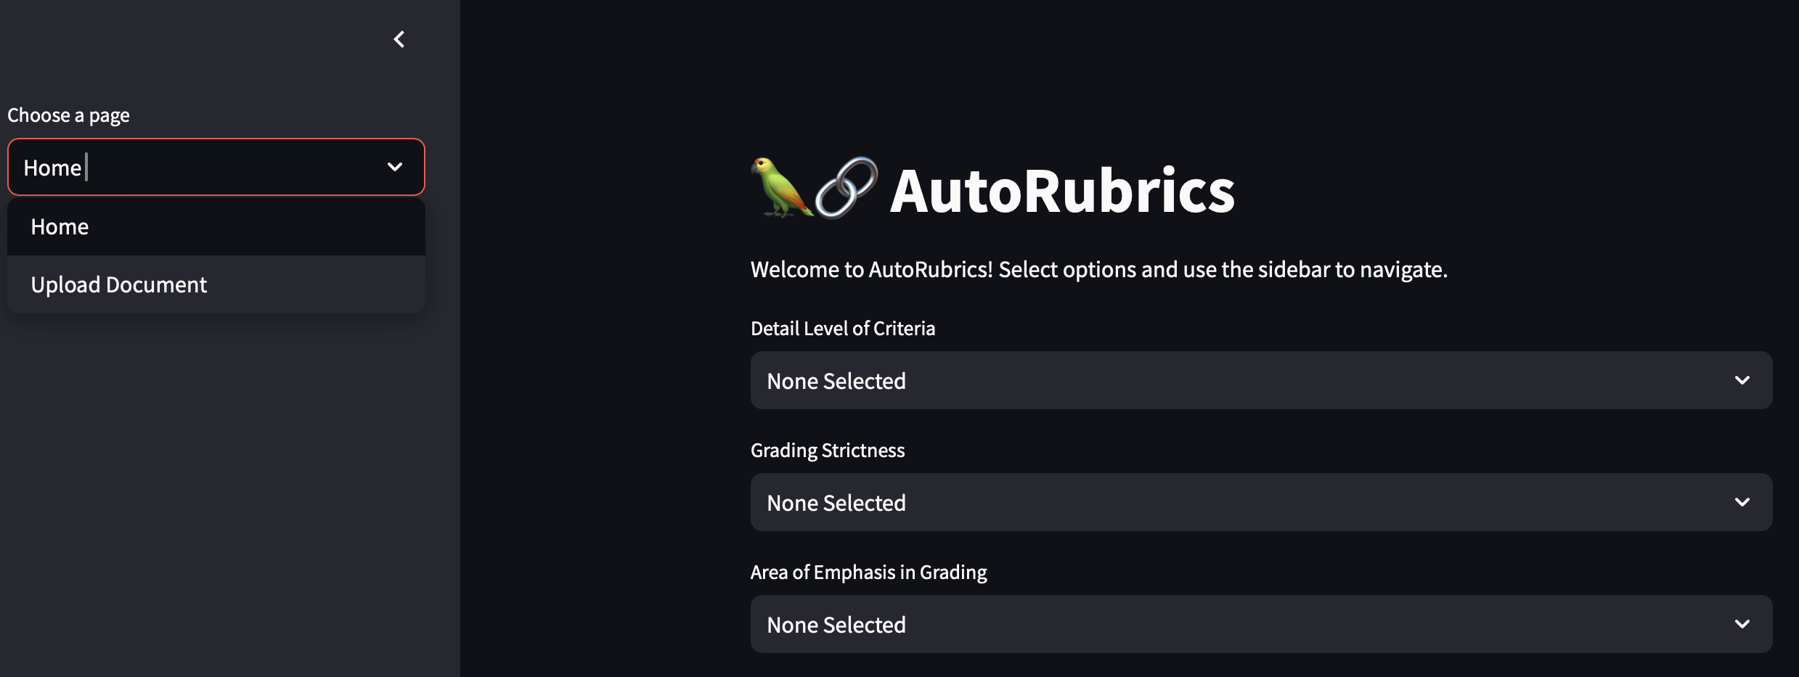
Home Page

Slide 6
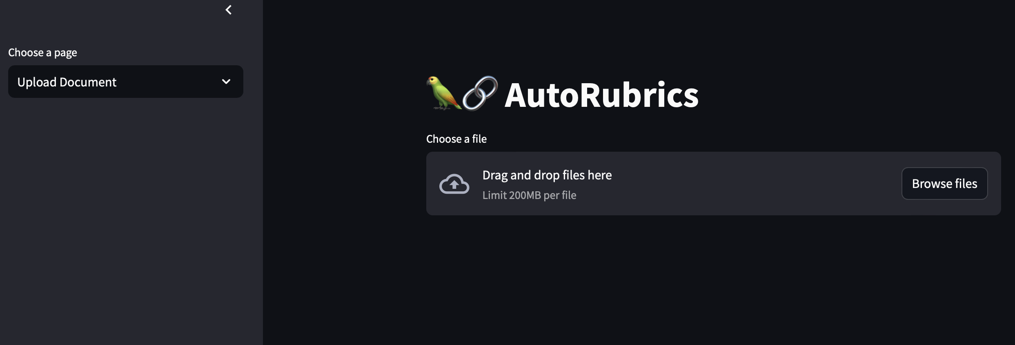
Upload Page

Slide 7
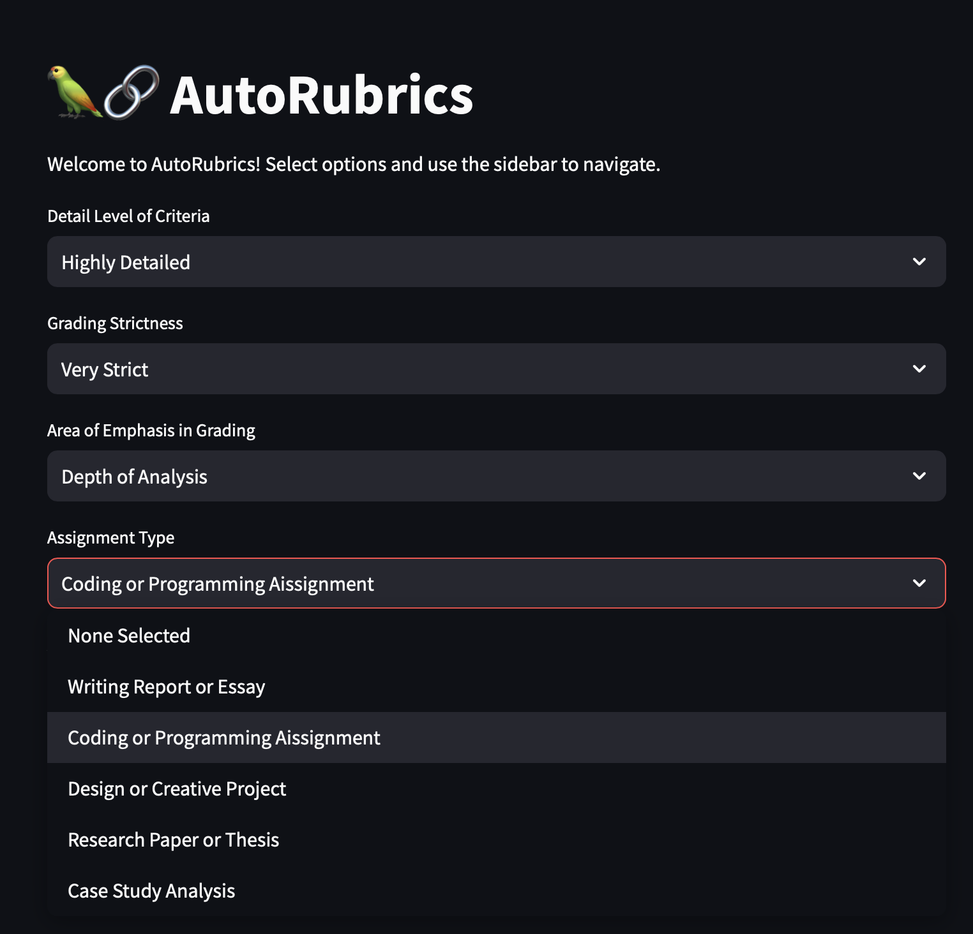
Options Interface

Slide 8
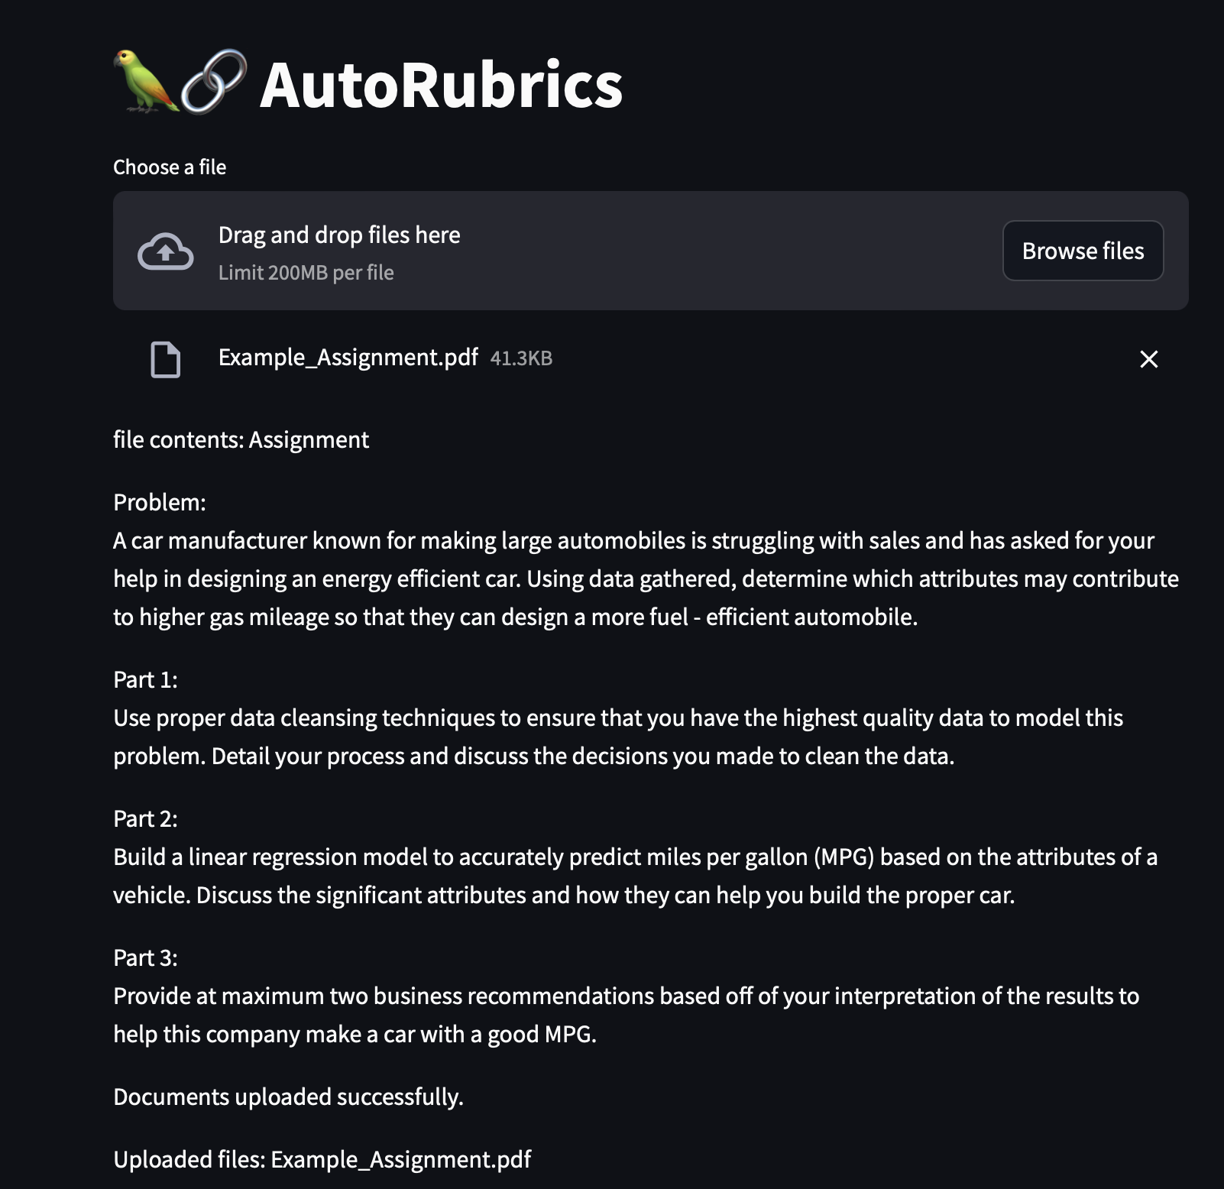
File Interface

Slide 9
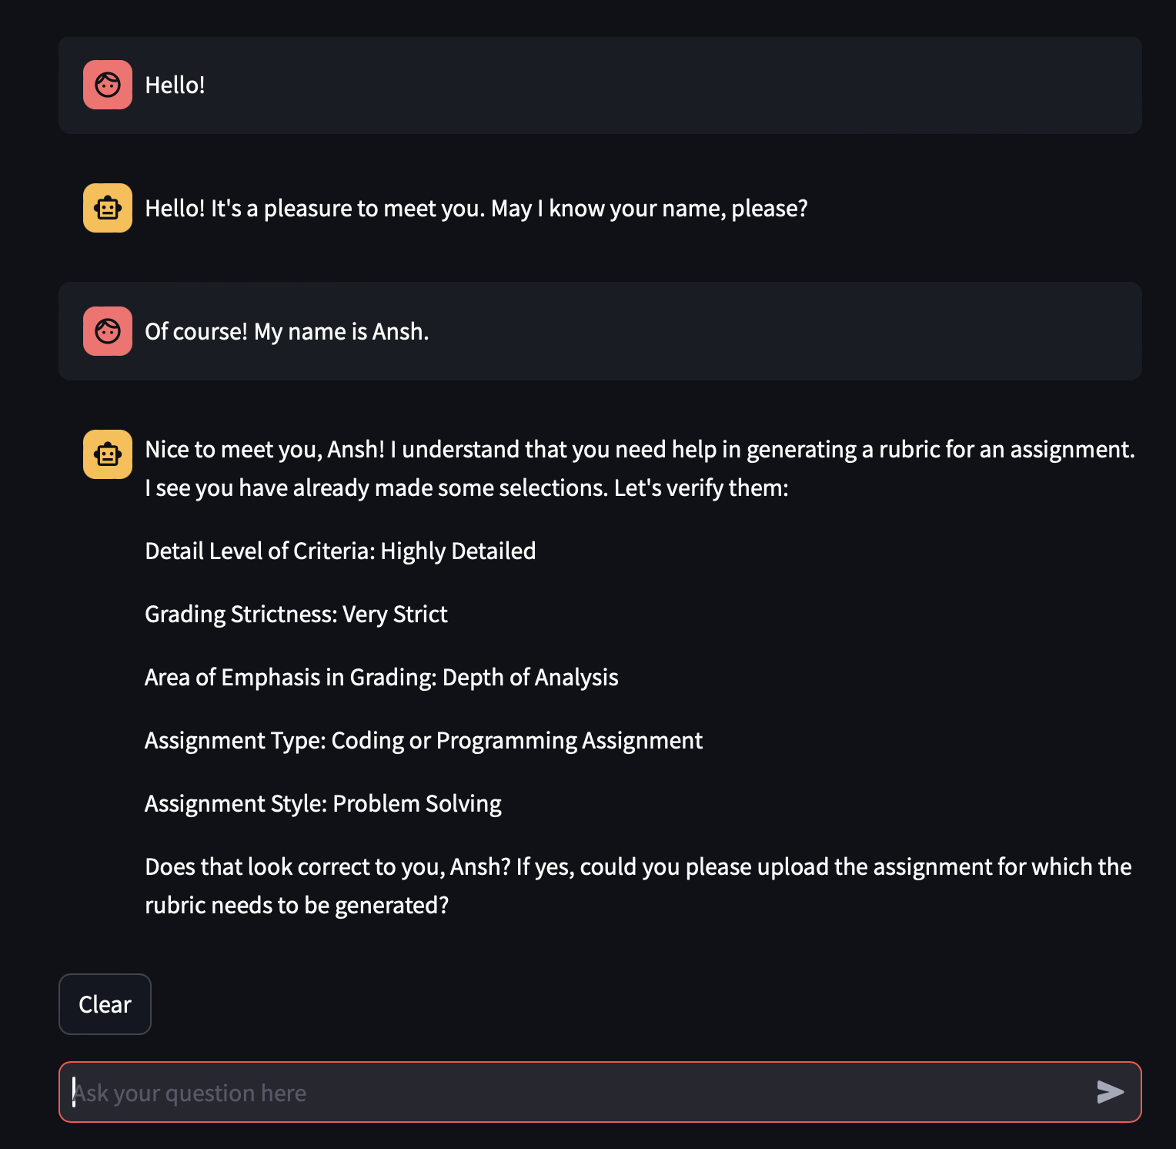
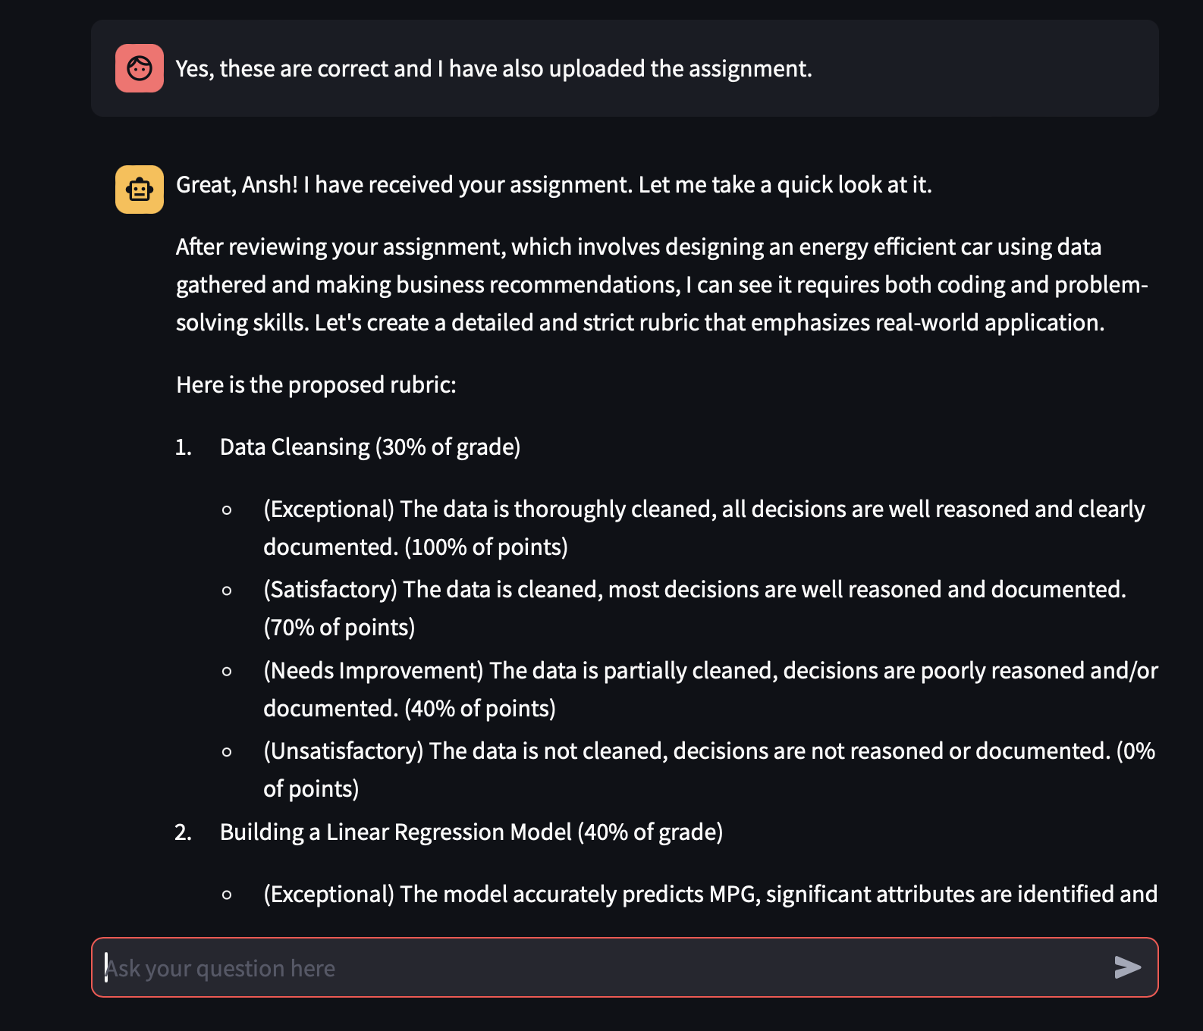
Chat Interface

Slide 10
SCOPE OF THE PROJECT
Prototype Development: Create a robust prototype for generating rubrics across various educational contexts.
Scalable Architecture: Design a scalable system to handle large user volumes and diverse grading needs.
AI Integration: Utilize advanced AI and LLM algorithms for precise and adaptable rubric creation.
Performance Evaluation: Conduct rigorous testing and validation to ensure optimal system performance.
User Documentation: Provide comprehensive documentation and user guides for effective system utilization.

Slide 11


Technical Requirements
Chroma
LangChain
OpenAI
StreamLit

Slide 12
Methodology
Integration of Chroma and LLM: Combining Chroma's robust vector database engine with large language models (LLMs) enhances the system's ability to manage educational data and interpret complex grading criteria accurately.
Development with Langchain: Utilizing Langchain's comprehensive framework to integrat Streamlit’s key features like option selection and file uploading. This makes the system adaptable and user-friendly, allowing educators to customize rubrics effortlessly and handle diverse queries effectively.

Slide 13
Conclusion
The AI-driven Automated Rubric Generation System stands as a transformative solution in the realm of educational assessment. By leveraging advanced AI and LLM technologies, this project aims to streamline the grading process, enhance reliability, and ensure fairness in evaluations. With its user-friendly interface and scalable architecture, the system is poised to significantly improve educational productivity and outcomes. By addressing key challenges in traditional grading methods, this innovative approach promises to empower educators and enrich the educational experience for students.

Slide 14

Questions?

Slide 15

Thank you

